Slide 1

LOGGING INTO CANVAS
VISUAL QUICK GUIDE

Slide 2
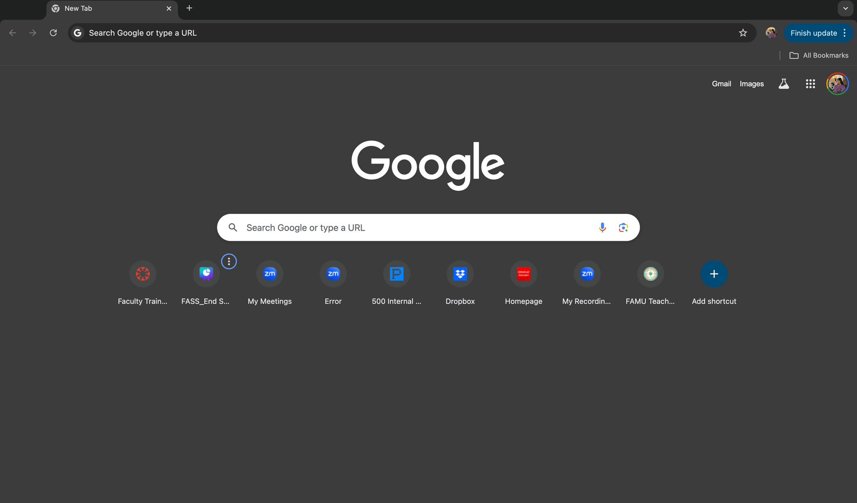
STEP 1
OPEN YOUR PREFFERED BROWSER

Slide 3
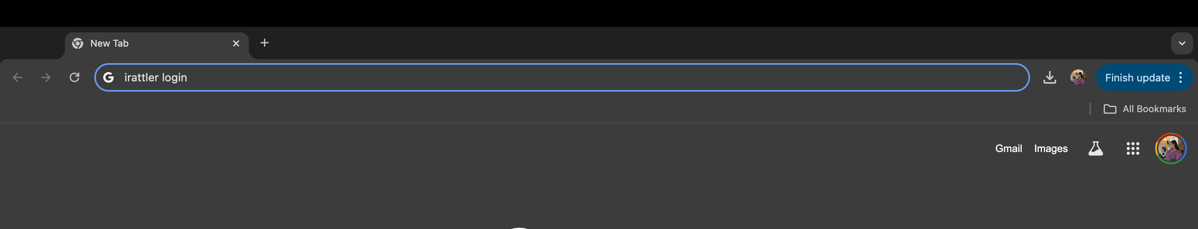

STEP 2
IN THE SEARCH BAR TYPE “IRATTLER LOGIN”, THEN PRESS ENTER

Slide 4
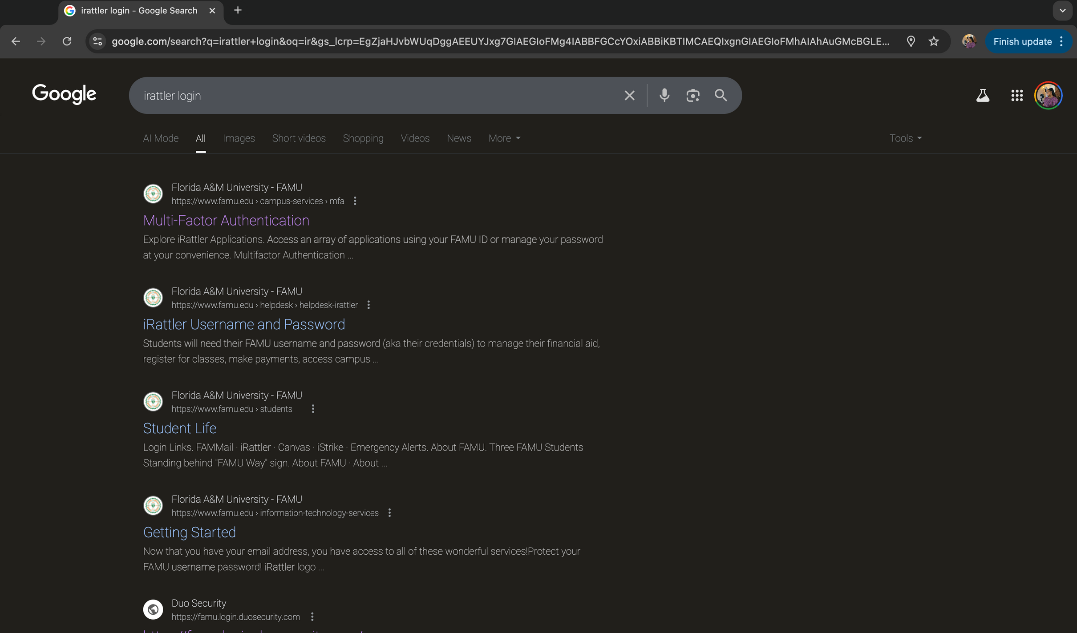

STEP 3
SUGGESTIONS FROM YOUR BROWSER WILL APPEAR, CLICK “MULTI-FACTOR AUTHENTIFICATION”

Slide 5

STEP 4
YOUR BROWSER WILL OPEN UP TO FAMU’S ITS MULTI-FACTOR AUTHENTIFICATION PAGE

Slide 6
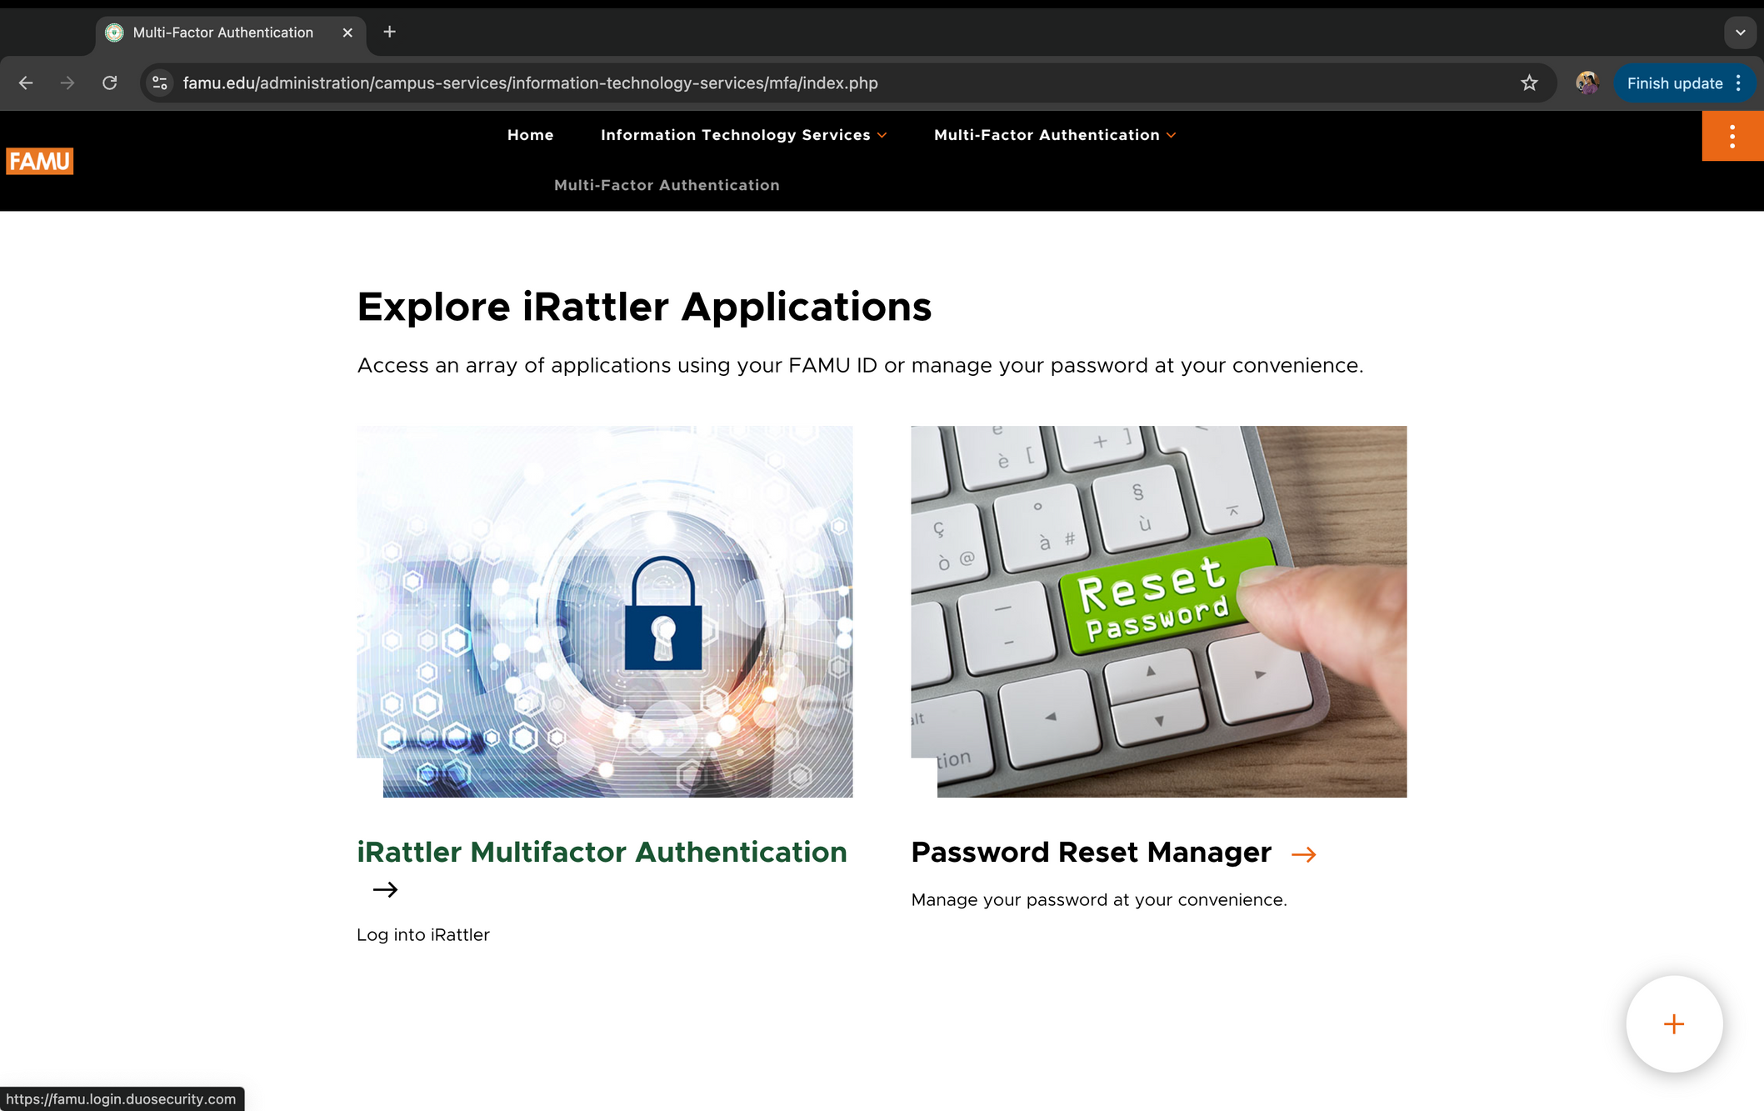
STEP 5
SCROLL DOWN AND CLICK “ IRATTLER MUTIFACTOR AUTHENTIFICATION”

Slide 7
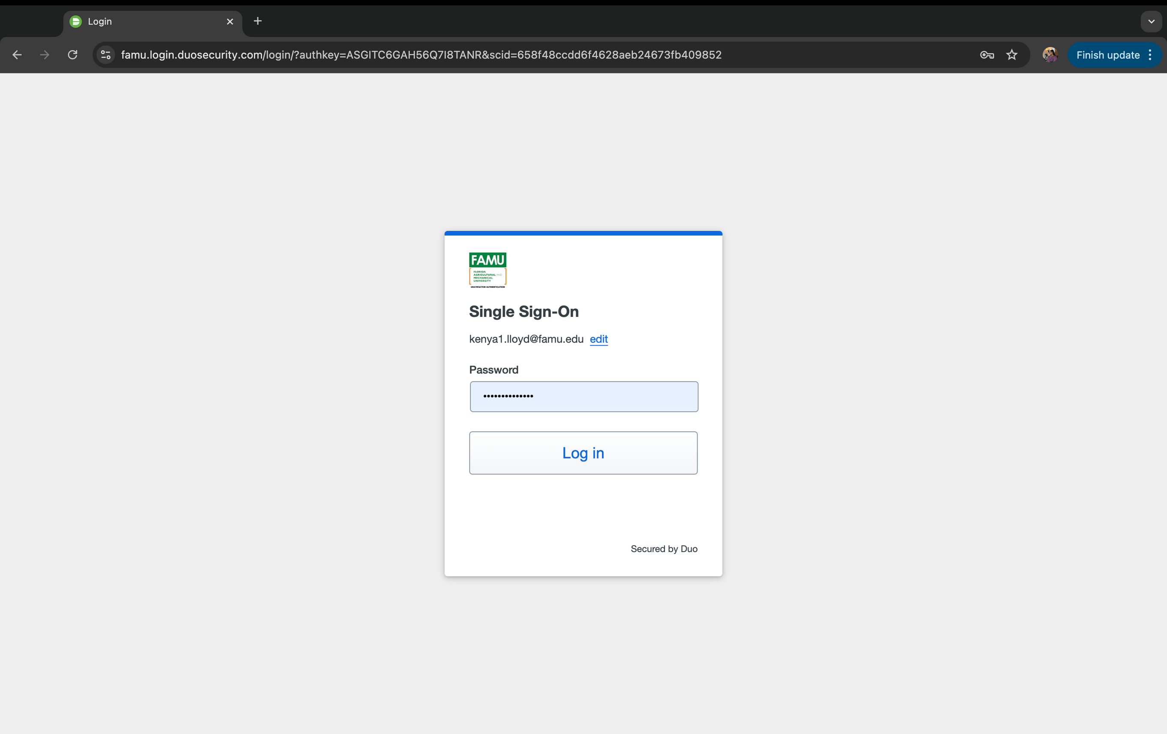
STEP 5
LOGIN WITH YOUR FAMU CREDENTIALS AND APPROVE LOGIN ON DUO

Slide 8
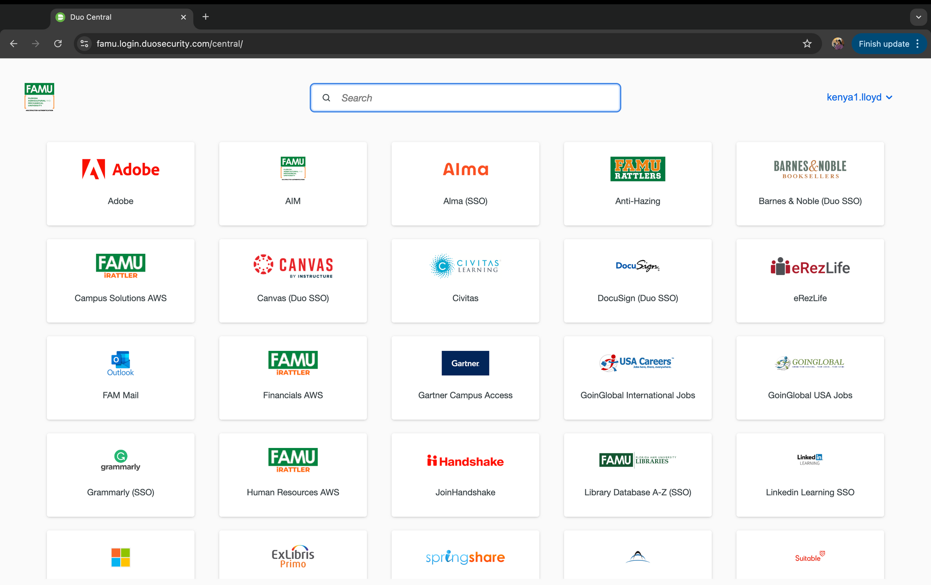
STEP 6
YOUR BROWSER WILL OPEN UP TO YOUR TILES IN IRATTLER

Slide 9
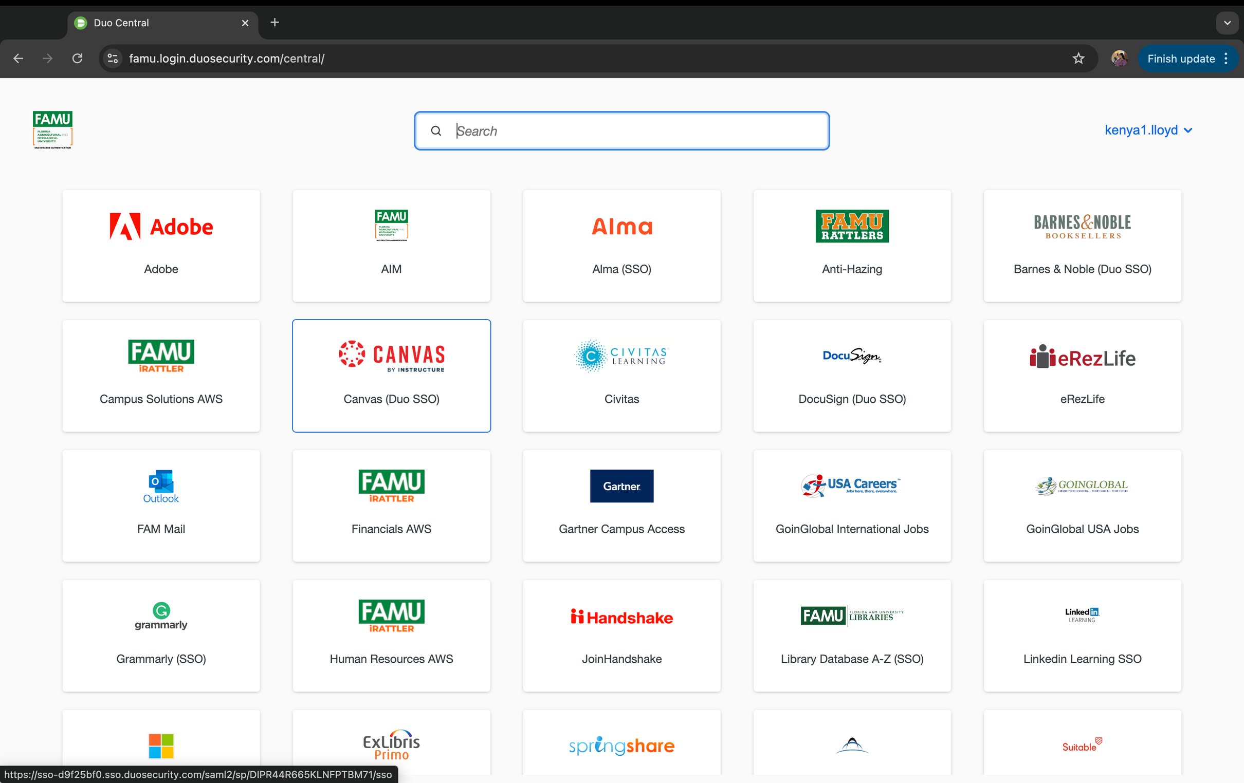

CLICK THE CANVAS TILE
STEP 7

Slide 10
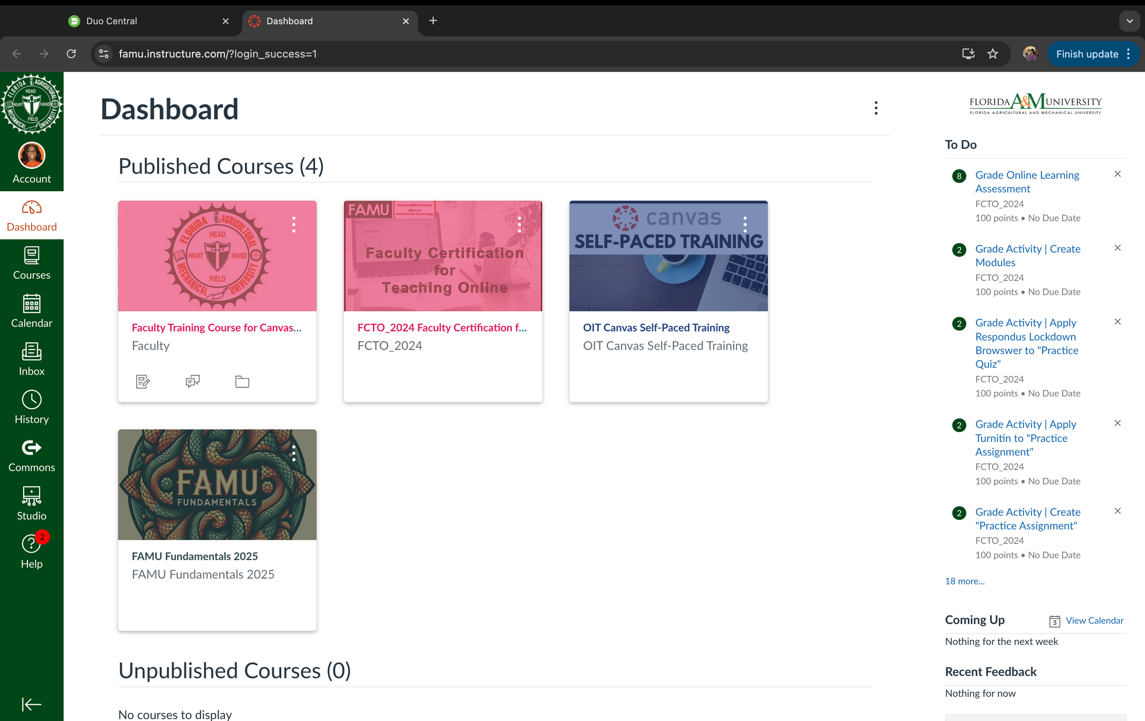
STEP 8
CANVAS WILL OPEN IN ANOTHER TAB

